Slide 1
Sales Pipeline and Monitoring Dashboard
Ballings Group 777
Katie Watts, Carys Van Atta, and Olivia Helms
Notes:
Today we’ll walk you through the end-to-end automated feature store pipeline we built for this project.

Slide 2
Architectural Design
Ballings Group 777
Remote Data Source
Daily Pull Script
Local Disk
PostgreSQL Database
Flask API
DASH Dashboard

Slide 3
System Components
Ballings Group 777
Data Pulling
SQL Database
Flask API & Dashboard
Daily automated pull
Stores raw data
Cleans and prepares features
Logs latest pull date
Stores historical records
Prevents duplicates
Supports analytics + API queries
Data endpoint returns
Dashboard shows KPIs & data quality
Interactive filters
Pipeline freshness indicator

Slide 4
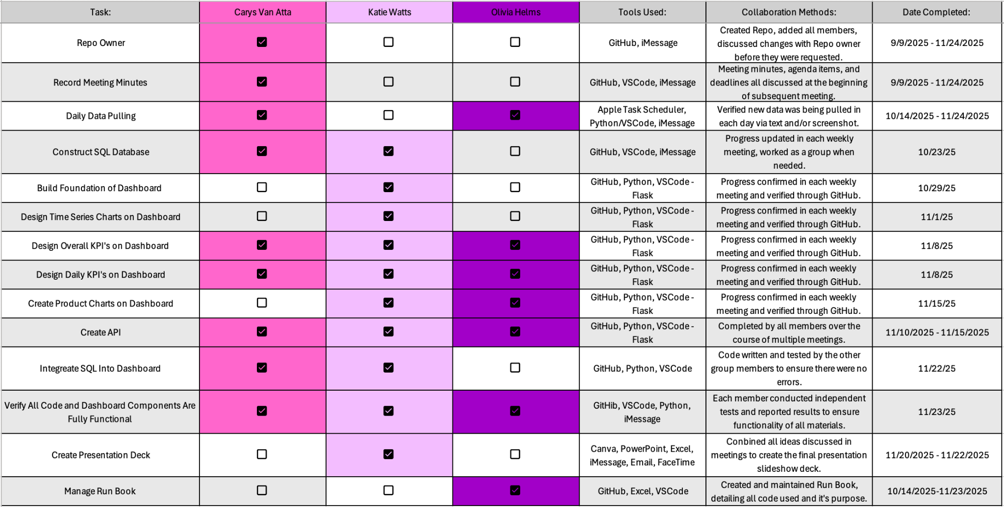
Team Responsibilities
Ballings Group 777

